Slide 1


Slide 2


Slide 3

James Bond

Slide 4


Slide 5
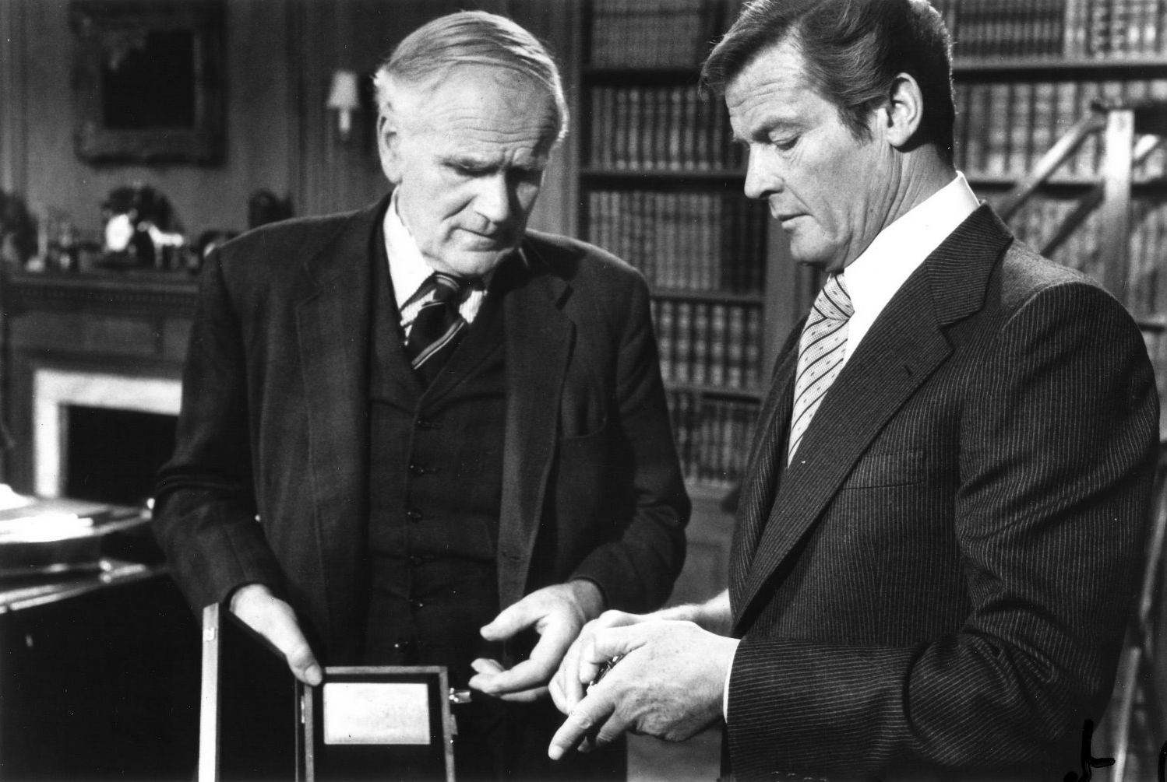
Q - Quartermaster

Slide 6
Q-Branch
Web Services for every occasion

Slide 7
GoldFinger
It's not perfected yet.
Q

Slide 8
Wing Ming Chan's Cascade Web Services in PHP

Slide 9
Great.
Now What?

Slide 10
Markdown
daringfireball.net/projects/markdown/
(specifically Parsedown)

Slide 11
*This* is bold
_This_ Is Italic
# This is a header
[And a link](http://…)
Markdown basics

Slide 12

Terminal

Slide 13
Why not use the WYSIWYG?

Slide 14
BlockMaker

Slide 15
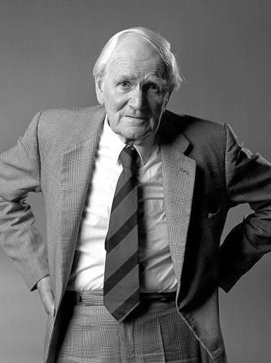
Markdown to WYSIWYG Blocks
What is Does
Takes plain text Markdown document
Converts to HTML
Breaks up content at <hr>
Creates WYSIWYG block with <h1> as block name

Slide 16
Source
# Admission Intro
At Christopher Newport you’ll learn the answers to two very important questions: *What am I good at? and What do I love to do?* Whatever your passions lead you to study – from engineering to philosophy, from music to accounting – the liberal arts and sciences are the foundation of your academic endeavors. Here we don’t teach you to do something; we prepare you to do _anything_.

Slide 17
In Terminal
The Command
blockMaker$ php index.php Admission test.txt

Slide 18
In Terminal
The Command
{
blockMaker$ php index.php Admission test.txt
Folder

Slide 19
In Terminal
The Command
{
blockMaker$ php index.php Admission test.txt
Use PHP

Slide 20
In Terminal
The Command
{
blockMaker$ php index.php Admission test.txt
The PHP File

Slide 21
In Terminal
The Command
{
blockMaker$ php index.php Admission test.txt
The folder in the “content” site

Slide 22
In Terminal
The Command
{
blockMaker$ php index.php Admission test.txt
Markdown file

Slide 23
PHP
<?php
$Parsedown = new Parsedown();
$folderName = $argv[1];
$html = $Parsedown->
text($folderParameter);
$rows = preg_split('/<hr \/>/',
$html, -1, preg_split_offset_capture
| PREG_SPLIT_DELIM_CAPTURE |
PREG_SPLIT_NO_EMPTY);
Get Parsedown ready

Slide 24
PHP
<?php
$Parsedown = new Parsedown();
$folderName = $argv[1];
$html = $Parsedown->
text($folderParameter);
$rows = preg_split('/<hr \/>/',
$html, -1, preg_split_offset_capture
| PREG_SPLIT_DELIM_CAPTURE |
PREG_SPLIT_NO_EMPTY);
Get the folder name

Slide 25
PHP
<?php
$Parsedown = new Parsedown();
$folderName = $argv[1];
$html = $Parsedown->
text($folderParameter);
$rows = preg_split('/<hr \/>/',
$html, -1, preg_split_offset_capture
| PREG_SPLIT_DELIM_CAPTURE |
PREG_SPLIT_NO_EMPTY);
Convert Markdown to HTML

Slide 26
PHP
<?php
$Parsedown = new Parsedown();
$folderName = $argv[1];
$html = $Parsedown->
text($folderParameter);
$rows = preg_split('/<hr \/>/',
$html, -1, preg_split_offset_capture
| PREG_SPLIT_DELIM_CAPTURE |
PREG_SPLIT_NO_EMPTY);
Split at the <hr /> tag

Slide 27
Text
foreach($rows as $row) {
preg_match('/^<h[1-4]>(.*)<\/h[1-4]>$/m', $row, $title);
$blockTitle = preg_replace('/[^\w]/', '', $title[1]);
$data_definition = $cascade->getAsset(
a\DataDefinition::TYPE,
'widgets/widget', '__main' );
$block_folder = $cascade->getAsset(
a\Folder::TYPE,
$baseFolder->getId(), $siteName );
Find the first header tag.
Make that the block title

Slide 28
Text
foreach($rows as $row) {
preg_match('/^<h[1-4]>(.*)<\/h[1-4]>$/m', $row, $title);
$blockTitle = preg_replace('/[^\w]/', '', $title[1]);
$data_definition = $cascade->getAsset(
a\DataDefinition::TYPE,
'widgets/widget', '__main' );
$block_folder = $cascade->getAsset(
a\Folder::TYPE,
$baseFolder->getId(), $siteName );
Getting the Data Definition and Folder

Slide 29
Text
$cascade->
createDataDefinitionBlock(
$block_folder, $blockTitle,
$data_definition )->
setText('type', 'Generic')->
setText( 'content', $row )->
edit();
}

Slide 30
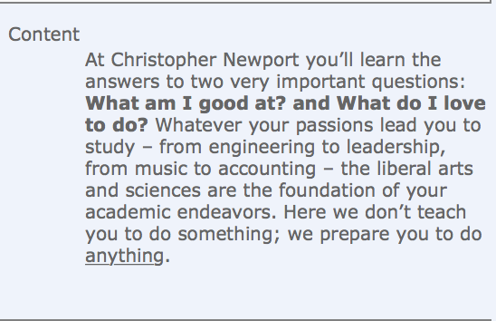
Input
Text
Output
# Admission Intro
At Christopher Newport you’ll learn the answers to two very important questions: *What am I good at? and What do I love to do?* Whatever your passions lead you to study – from engineering to philosophy, from music to accounting – the liberal arts and sciences are the foundation of your academic endeavors. Here we don’t teach you to do something; we prepare you to do _anything_.

Slide 31


Slide 32
LearnMaker

Slide 33
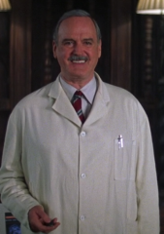

CSV to “Learn More” link Block
What it does
Formatted CSV is parsed
Block is created
Links are built based on whether internal or external

Slide 34
The CSV File
The CSV File
Link Type (I/E) | Internal Site Name | Internal Link Path | Internal Type (P/F) | Internal Anchor | External URL | Link text - Custom
I | Admin - Visit | directions/index | P |  |  | Directions to Campus

Slide 35
In Terminal
Text
{
learnmaker$ php index.php -run learn.csv ↩︎ [_content/Folder ID] [block name]
Folder

Slide 36
In Terminal
Text
{
learnmaker$ php index.php -run learn.csv ↩︎ [_content/Folder ID] [block name]
Use PHP

Slide 37
In Terminal
Text
{
learnmaker$ php index.php -run learn.csv ↩︎ [_content/Folder ID] [block name]
The PHP File

Slide 38
In Terminal
Text
{
learnmaker$ php index.php -run learn.csv ↩︎ [_content/Folder ID] [block name]
Run flag

Slide 39
In Terminal
Text
{
learnmaker$ php index.php -run learn.csv ↩︎ [_content/Folder ID] [block name]
CSV File

Slide 40
In Terminal
Text
learnmaker$ php index.php -run learn.csv ↩︎ [_content/Folder ID] [block name]
{
The folder

Slide 41
In Terminal
Text
learnmaker$ php index.php -run learn.csv ↩︎ [_content/Folder ID] [block name]
{
The block name

Slide 42
This one is a little more complex…
Full Source code is available

Slide 43
Some important things…

Slide 44
First Link
PHP
Second + links
echo 'Should be setting the link fields…' . PHP_EOL;
echo $externalURL . PHP_EOL;
$linkType = 'External';
echo $linkType . PHP_EOL;
$learnMoreBlock->
setText(
'link;0;link-type',
$linkType )->
setLinkable(
'link;0;internal',
NULL )->
setText(
'link;0;external',
$externalURL )->
setText(
'link;0;link-text-chooser',
'Custom Text' )->
setText(
'link;0;custom',
$linkText )->
edit(); // Commit!
$siblings++;
echo $externalURL . PHP_EOL;
$linkType = 'External';
echo $linkType . PHP_EOL;
$learnMoreBlock->appendSibling( 'link;0' )->
setText(
'link;' . $siblings . ';link-type',
$linkType )->
setLinkable(
'link;' . $siblings . ';internal',
NULL )->
setText(
'link;' . $siblings . ';external',
$externalURL )->
setText(
'link;' . $siblings . ';link-text-chooser',
'Custom Text' )->
setText(
'link;' . $siblings . ';custom',
$linkText )->
edit(); // Commit!
$siblings++;

Slide 45
First Link
PHP
Second + links
echo 'Should be setting the link fields…' . PHP_EOL;
echo $externalURL . PHP_EOL;
$linkType = 'External';
echo $linkType . PHP_EOL;
$learnMoreBlock->
setText(
'link;0;link-type',
$linkType )->
setLinkable(
'link;0;internal',
NULL )->
setText(
'link;0;external',
$externalURL )->
setText(
'link;0;link-text-chooser',
'Custom Text' )->
setText(
'link;0;custom',
$linkText )->
edit(); // Commit!
$siblings++;
echo $externalURL . PHP_EOL;
$linkType = 'External';
echo $linkType . PHP_EOL;
$learnMoreBlock->appendSibling( 'link;0' )->
setText(
'link;' . $siblings . ';link-type',
$linkType )->
setLinkable(
'link;' . $siblings . ';internal',
NULL )->
setText(
'link;' . $siblings . ';external',
$externalURL )->
setText(
'link;' . $siblings . ';link-text-chooser',
'Custom Text' )->
setText(
'link;' . $siblings . ';custom',
$linkText )->
edit(); // Commit!
$siblings++;

Slide 46
you have to count the siblings.

Slide 47


Slide 48
FacultyMaker

Slide 49
Builds Faculty Profile pages
what it does
Pulls data from Digital Measures
Parses data into Data Definition Block
Adds faculty photo Data Definition Block
Creates Folder and Page
Adds both Data Definition Block to page

Slide 50
Casino royale
I'm afraid I'm a complicated woman.
Vesper Lynd

Slide 51
Things to Note
Faculty update their profile data in Digital Measures, using Markdown
Data is pulled as part of a scheduled task
Publish happens as part of a scheduled publish set
Faculty photos are identified by a hash of their ID number
No ID numbers published
Collisions are avoided

Slide 52
Highlights
New profiles are created automatically
Automatically updated profiles
Customizable department metadata
Unlimited degrees
Bios
Teaching and Research focuses
Faculty update their data
Consistent presentation, consistent degrees, consistent titles

Slide 53

The future
Addition of publications and presentations
Automated removal
?

Slide 54
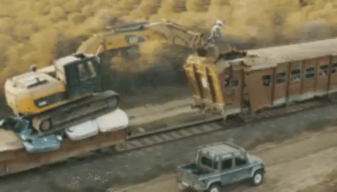

Slide 55
On Her Majesty's Secret Service
Thank you, but this time I have the gadgets and I know how to use them.
JAMES BOND

Slide 56


Slide 57
License to Kill
Remember, if it hadn't been for Q Branch, you'd have been dead long ago.
Q

Slide 58
@jeredB
github.com/jeredb/CUC17

